Slide 1
Strategic Clarity
Interested/warm (high interest and/or warm to the brand/message)
Explicit (focus on communicating specific message)
ACTIVATING
This is where the priority is delivering information to an interested audience. Therefore the focus is cost efficient reach of an audience that is sensitised to the message and therefore already likely to notice. And allow for audience to have deeper access to more information.
REINFORCING
This is where the priority is reinforcing existing associations. Therefore the focus is for a strategy that can refreshing existing memory structures – aiming for recency, in order to influence purchase/action.
Implicit (focus is on building or reinforcing associations)
IMPACTING
This is where the priority is delivering information to an audience that has a low probability to be interested. Therefore the focus is achieving cut-through - either through interruption or engagement.
AUGMENTING
This is where the priority is (re)building new memory-structures onto the brand. Therefore the focus is for a strategy that can build new memory through emotional and frequency.
Disinterested/cool (low interest or cool feelings towards brand/message)

Slide 2
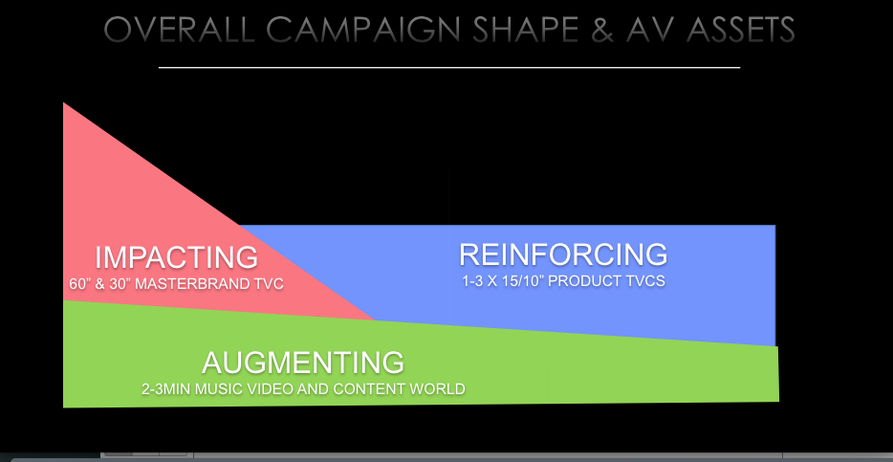
Strategic Clarity

